Slide 1




Methods of diagnostic and evaluation of disease severity in patients with chronic hepatitis C
Andreea Cazan
M.D., Gastroenterology
“Dr. Victor Babeș” Infectious and Tropical Diseases Hospital, Bucharest
University of Medicine and Pharmacy “Carol Davila”, Bucharest

Slide 2
Summary
Case presentation
Chronic hepatitis C progression
Importance of liver disease evaluation at diagnosis
Evaluation of patients at the moment of diagnosis
Importance of the follow-up after hepatitis C cure

Slide 3
Introduction
Hepatitis C infection → chronic liver disease (75-85% of cases)
The IFN-free treatment is highly effective, but sometimes the fibrosis won’t regress after the cure

Slide 4
Case presentation
Male patient, 30 years old, worker-commercial
History of incarceration a few years ago, in Austria
Diagnosed at age of 25 years with chronic hepatitis C, lost to follow-up (F2???)
Comes back to the general practitioner for evaluation (He wants the new treatment!!)

Slide 5
Case presentation
Clinical presentation: no jaundice, tattoos on both arms, without stigmata of cirrhosis
Work-up: ALT, AST 2xN, no cholestasis
Abdominal ultrasound: moderate steatosis, without portal hypertension
Addressed to the specialist for a complete evaluation

Slide 6
Case presentation
Infectious Diseases Department
Elevated aminotransferases, AgHBs positive, negative for Delta virus, HIV negative, high viral load for HBV
Fibroscan 15,3 kPa (F4), Fibrotest F4 (Rapid progression of fibrosis...)
Upper GI endoscopy – no esophageal varices
Is he eligible for treatment?

Slide 7
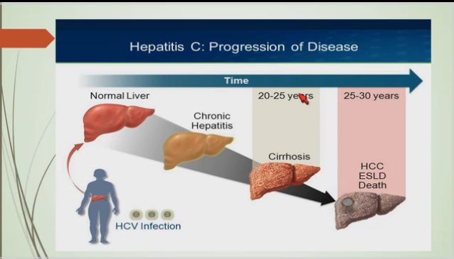
Progression of HCV infection
Zaki Sherif, Howard University Colleg of Medicine, DDW 2016

Slide 8
Liver fibrosis – natural history
Parallel linearity with age decades, but suffers an acceleration after the age of 40
Affected by: age, alcohol consumption, insulino resistance, coinfections ( HIV)

Slide 9
The importance of fibrosis evaluation
New antivirals era, expensive drugs (priority of treatment for severe fibrosis)
Advanced fibrosis (cirrhosis) needs long term follow-up
Cured infection ≠ cured liver disease

Slide 10
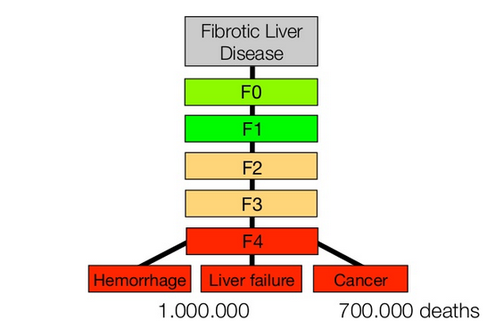
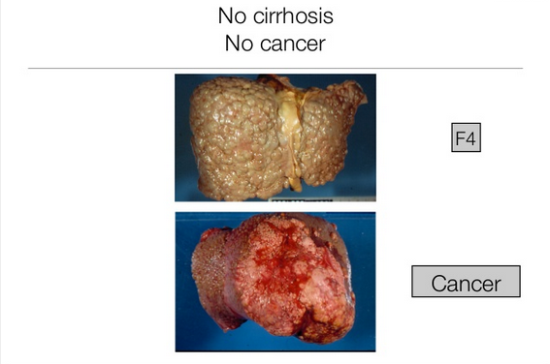
The importance of fibrosis evaluation
Poynard, Lancet, 1997

Slide 11
Evaluation of liver disease severity in newly diagnosed patient (1)
Clinical → stigmata of cirrhosis:
Stellate angioma
Ginecomasty
Palmar erythrosis, jaundice
Ascites
Peripheral edema
Caput medusae
Sarcopenia
Hepatic encephalopathy

Slide 12
Evaluation of liver disease severity in newly diagnosed patient (2)
Abdominal ultrasound (available, iterative)
Can diagnose advanced liver disease

Slide 13
Evaluation of liver disease severity in newly diagnosed patient (3)
Pathology
Historically: Liver biopsy
Scores: Metavir, Knodell, Ishak
Calculated based on necroinflammatory activity and liver fibrosis
Liver biopsy remains the gold standard, but has been replaced by the noninvasive methods
Can be used in case of discordant results

Slide 14
Evaluation of liver disease severity in newly diagnosed patient (4)
Blood work-up:
Hepatic cytolysis, coinfections, comorbidities (diabetes), viral load
Decompensated cirrhosis (Child score)
APRI (AST to platelet ratio index)
Serum biomarkers: Fibrotest, Fibrosure, Fibromax

Slide 15
Fibrotest
The most validated test for evaluation of liver fibrosis in hepatits C
6 biological parameters, combined with age and sex of the patient: alfa-2-macroglobulin, haptoglobin, apolipoprotein A1, GGT, total bilirubin
Disadvantage: can’t discriminate with accuracy the intermediate grades of fibrosis (F1-F3)- similar with liver biopsy

Slide 16
Fibromax
Parameters:
Fibrosis (Fibrotest)
Necroinflammatory activity (Actitest)
Steatosis (Steatotest)
Nonalcoholic steatohepatitis (Nashtest)
Alcoholic steatohepatitis (Ashtest)
Additional biological markers: ALT, AST, cholesterol, triglycerides, serum glucose

Slide 17
Imagistic methods for quantification of liver fibrosis
Elastography
Fibroscan
ARFI
Shearwave
IRM

Slide 18
Fibroscan (Transient elastography)
Advantages: noninvasive, rapid, iterative, easy to perform
Disadvantages: availability, variability, false positive results (inflammation), false negative results (cirrhosis), should not be used in pregnant women

Slide 19
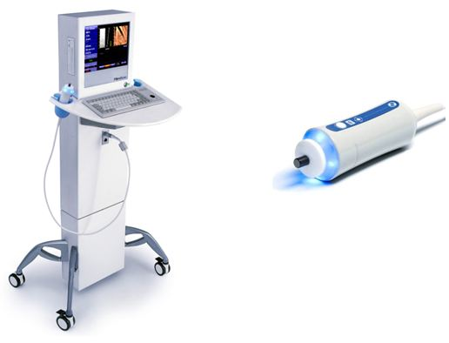
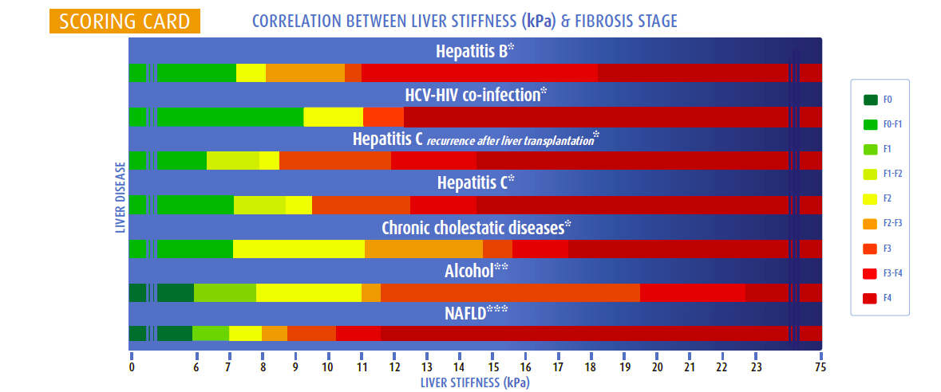
Fibroscan

Slide 20
Other methods
ARFI (acoustic radiation force impulse), Shear Wave Elastography: 2 new elastography methods, integrated in the ultrasound machines
IRM (Magnetic Resonance Elastography)

Slide 21
Upper Gi endoscopy
Indicated in patients with severe fibrosis (F4), for esophageal varices screening, at specific intervals (Baveno VI consensus)

Slide 22
Follow-up after HCV cure
After SVR → slow regression of fibrosis (sometimes, the fibrosis gets worse!)
F3/F4 → 6 months follow up (AFP, liver ultrasound) and upper GI endoscopy at specific intervals

Slide 23
Conclusions
The evaluation of liver disease severity is mandatory at the moment of diagnosis and periodically
Severe disease→ high morbidity, high costs
Antiviral therapy→ cost-efficient
Severe fibrosis→ Follow-up after HCV cure

Slide 24
So, mister M.C. should be treated? Definitely

Slide 25
Thank you!

